Slide 1

Pipe Overflow Prediction Model in Stormwater Networks and Visualization Using Mixed Reality
SeyedMojtaba Noghabaei
North Carolina State University

Slide 2

Outline
Introduction
Background and Objective Statement
Observed problems
Research Objective
Methodology
Proposed solution
Research method
ANN model
Mixed Reality
Results
Discussion
Limitation
Conclusion

Slide 3
Introduction
What is a working definition of smart cities
//
What smart city application area are you working in, and how does that area address or achieve the goals of a smart city.
//prediction

Slide 4
Definition of Smart Cities and Application Area
A smart city is an urban area that uses different types of electronic data collection sensors to supply information which is used to manage assets and resources efficiently.
This includes data collected from citizens, devices, and assets that is processed and analyzed to monitor and manage traffic and transportation systems, power plants, water supply networks, stormwater networks, waste management, law enforcement, information systems, schools, libraries, hospitals, and other community services.

Slide 5
Background and Objective Statement
What has been done in your specific area of smart city research
The review of literature should lead directly to a statement of what has not been done in this area. Specifically what has not been done that your project will address? What is the solution that your project demonstrates?
State very clearly: “ The objective of this research is to …”

Slide 6
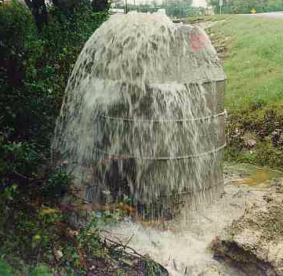
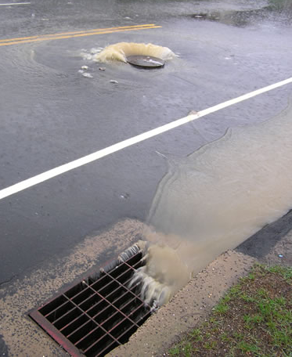
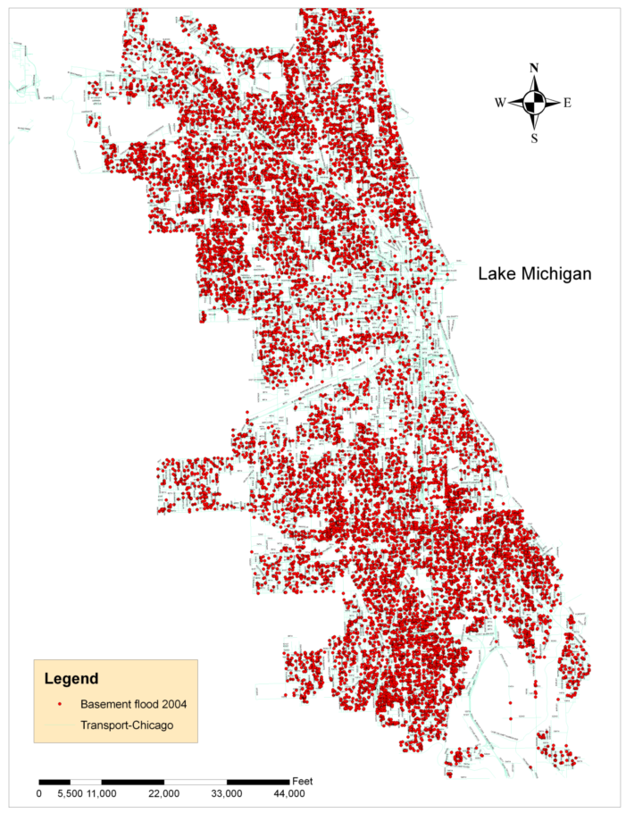
Observed Problems
Overflow in stormwater networks
Basement flooding complaints documented in Chicago during 2004

Slide 7
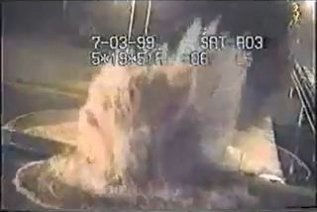
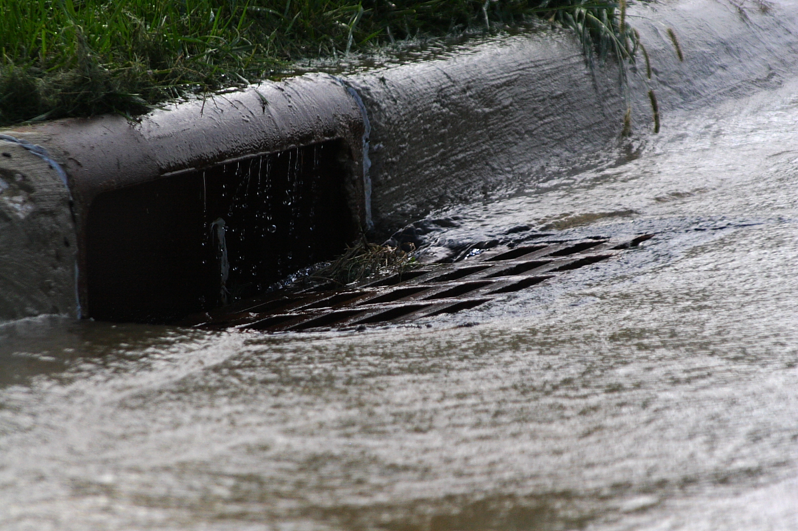

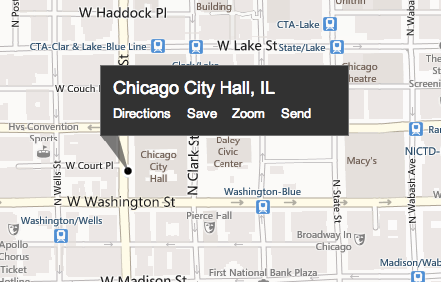
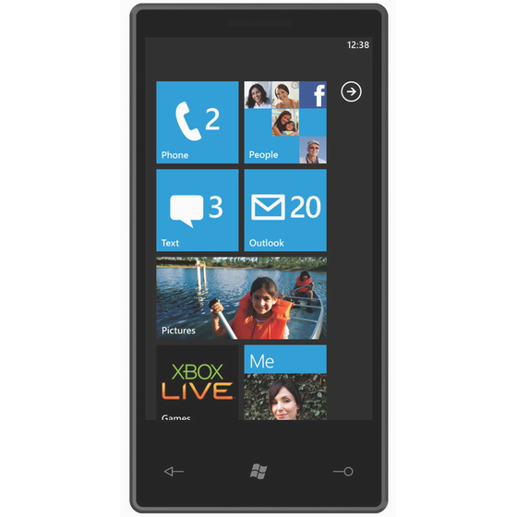
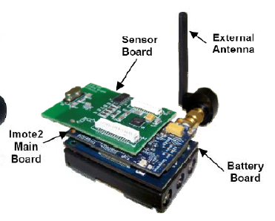

Observed Problems
Overflow in stormwater networks
Drainage
Overflow
Stormwater flow monitoring via low-cost sensor networks and social networking.
Basement flooding complaints documented in Chicago during 2004

Slide 8
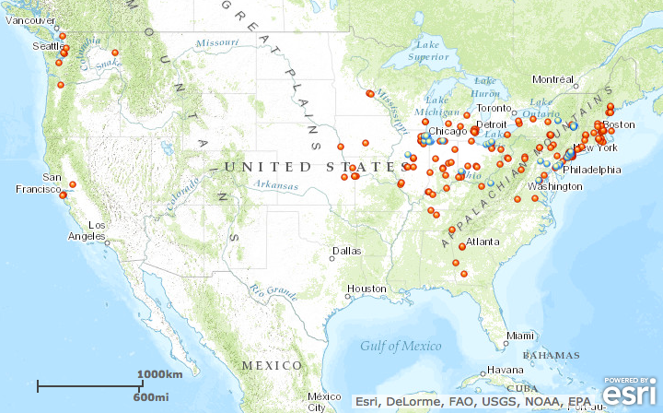
Observed Problems
Water Problems Elsewhere
Is it possible to predict them?

Slide 9
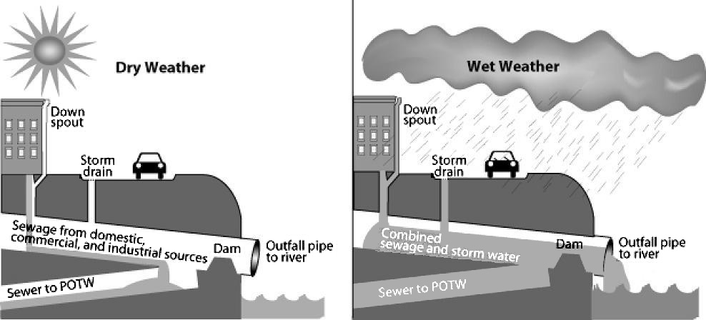
Observed Problems
Motivation
Changes to Infrastructure and Climate Impact Surface Runoff
• impervious surfaces captures larger volumes of precipitation
• larger storm events result in larger runoff volumes
Surface Runoff Changes Impact Combined Sewer Overflow
• dry weather conditions generally do not present a problem
• wet weather conditions can cause a CSO to occur
There are No Low-Cost Methods to Quantify CSO Outflow
• sensing systems require investment in proprietary hardware and software
• existing camera infrastructure can leverage computer vision algorithms

Slide 10
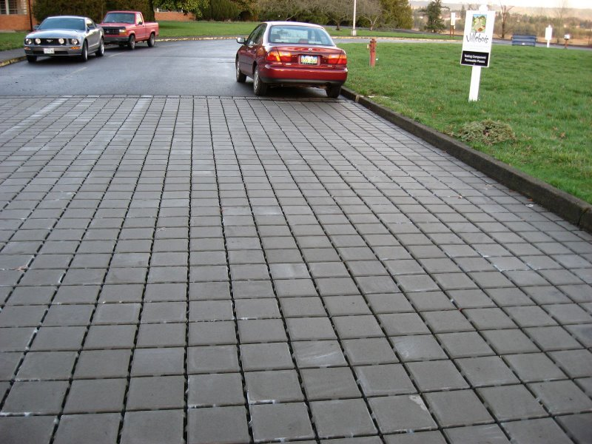
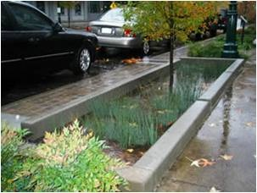
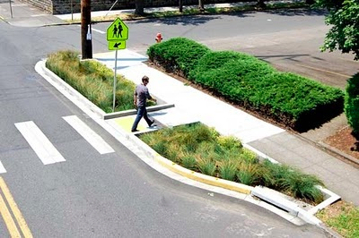
Observed Problems
What is Green Infrastructure?
Green infrastructure uses elements of vegetation, soils, and natural processes to manage water and create healthier urban environments.
Permeable Pavers
Infiltration Planters
Infiltration Bumpouts
In most urban areas, stormwater is drained through engineered collection systems and discharged into nearby waterways; trash, bacteria, heavy metals, and other pollutants from the urban landscape can all be included in the discharge.

Slide 11
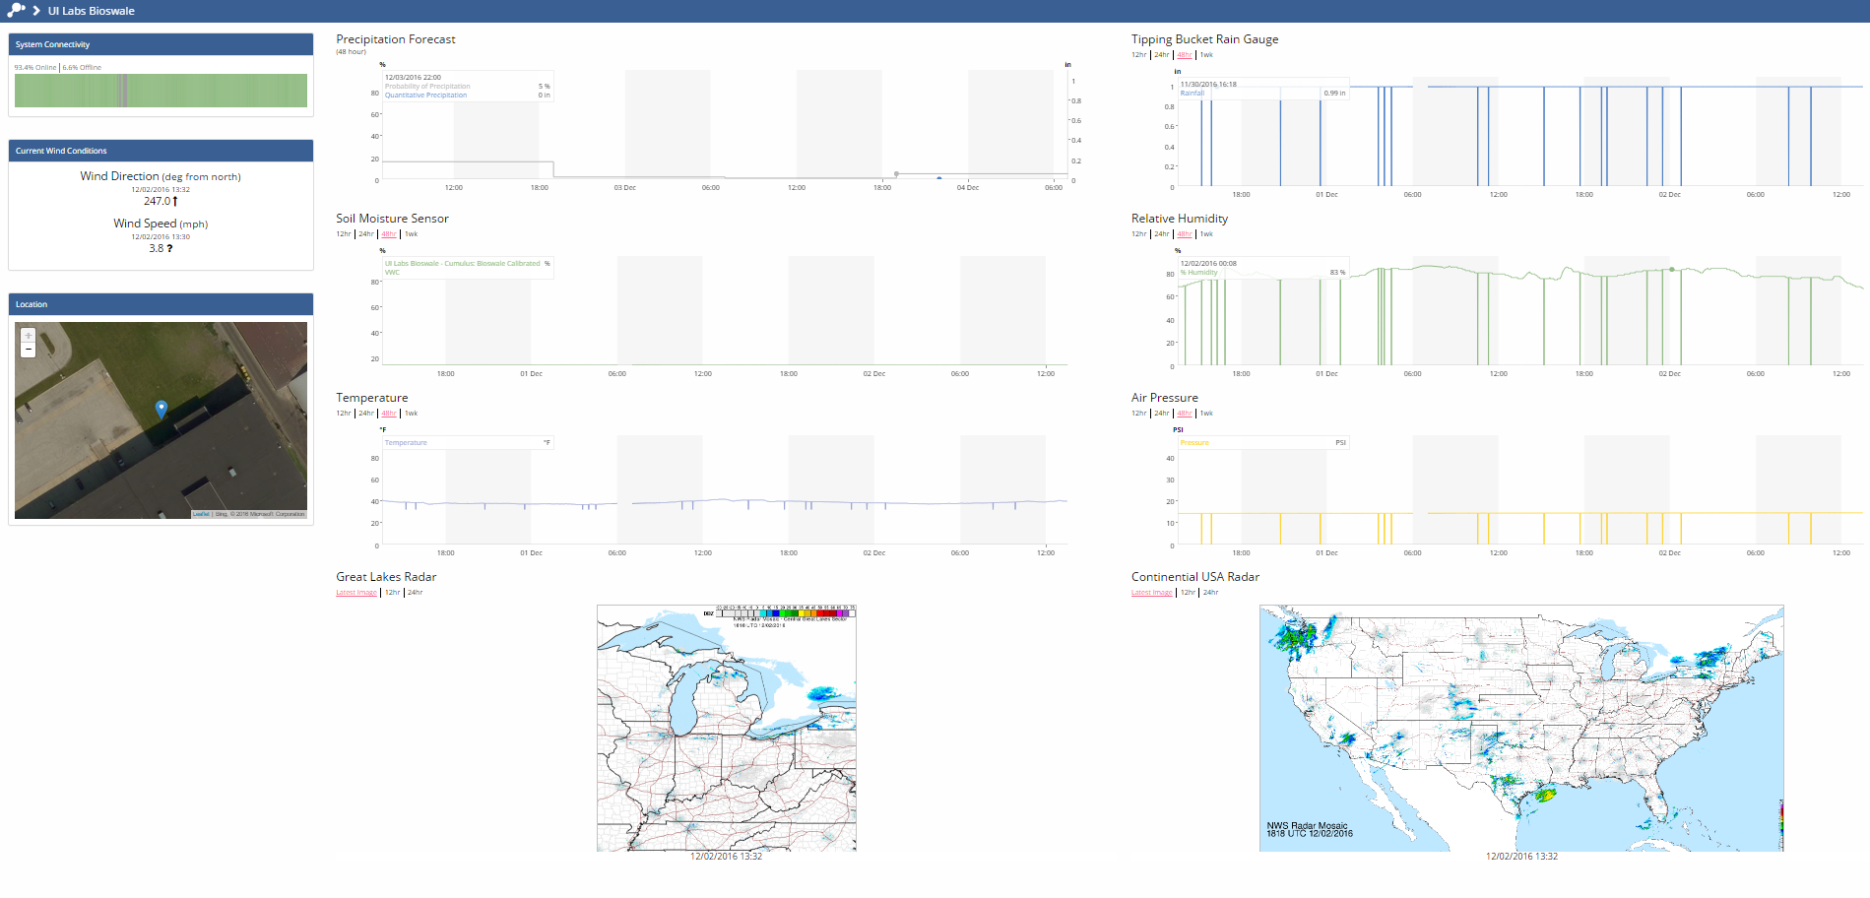
Visualization and Sense-Making
Current visualization approach for smart cities data
Notes:
Best decisions
Allocating resources during a disaster

Slide 12
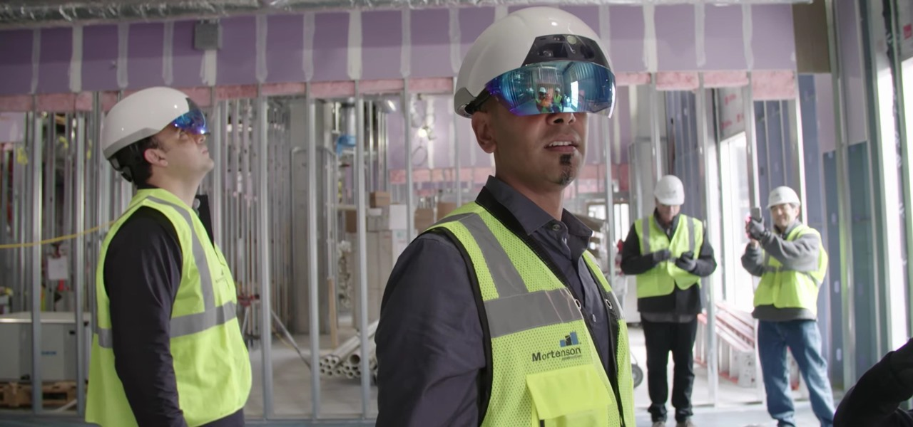

Data Visualization Challenges
Limited field of view of objects
Lack of real-time data dissemination
Lack of Features Enabling Collaboration
Smart visualization is the FIRST step toward becoming a truly smart city*
*Jan-Philipp Mohr(2017) “IMMERSIVE DATA VISUALIZATION FOR SMART CITIES”

Slide 13
Why Mixed Reality?
Mixed Reality allows to see at different scale, from different perspective.
Helps for optimal actions and decisions
When we see things we make progress
Allow to live experience in augmented and virtual environments
Notes:
We understood that visualization is important, but why MR ?

Slide 14
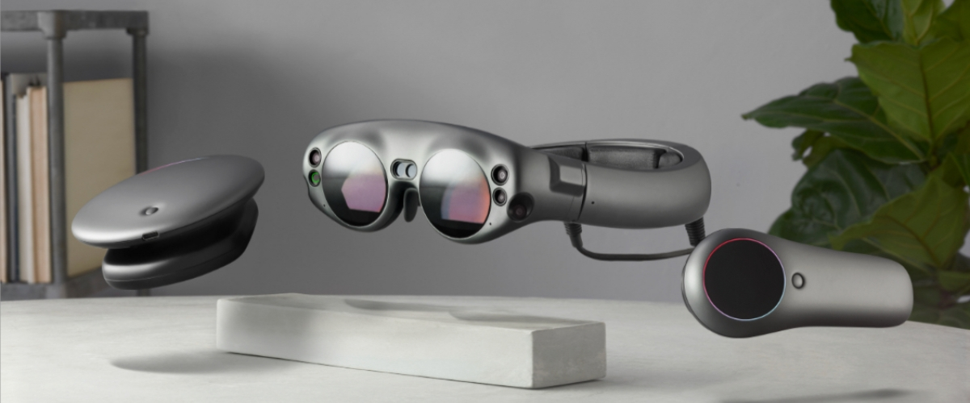
Why Mixed Reality?
AR/VR offer large possibilities to visualize complex urban systems, to live and share urban experience, to create emotional environment, to learn, to understand, to act together for the city.

Slide 15
Methodology
Describe the steps, tools, and data you use to achieve your objective.

Slide 16
Research Objectives
Create a platform to predict overflows in order to help utility managers before disasters.
Create a digital twin for the stormwater network and enable utility managers for better decision making using Mixed Reality technology.

Slide 17
Research Method
Data from previous overflows or SWMM
Predicting overflows
Visualize in MR

Slide 18
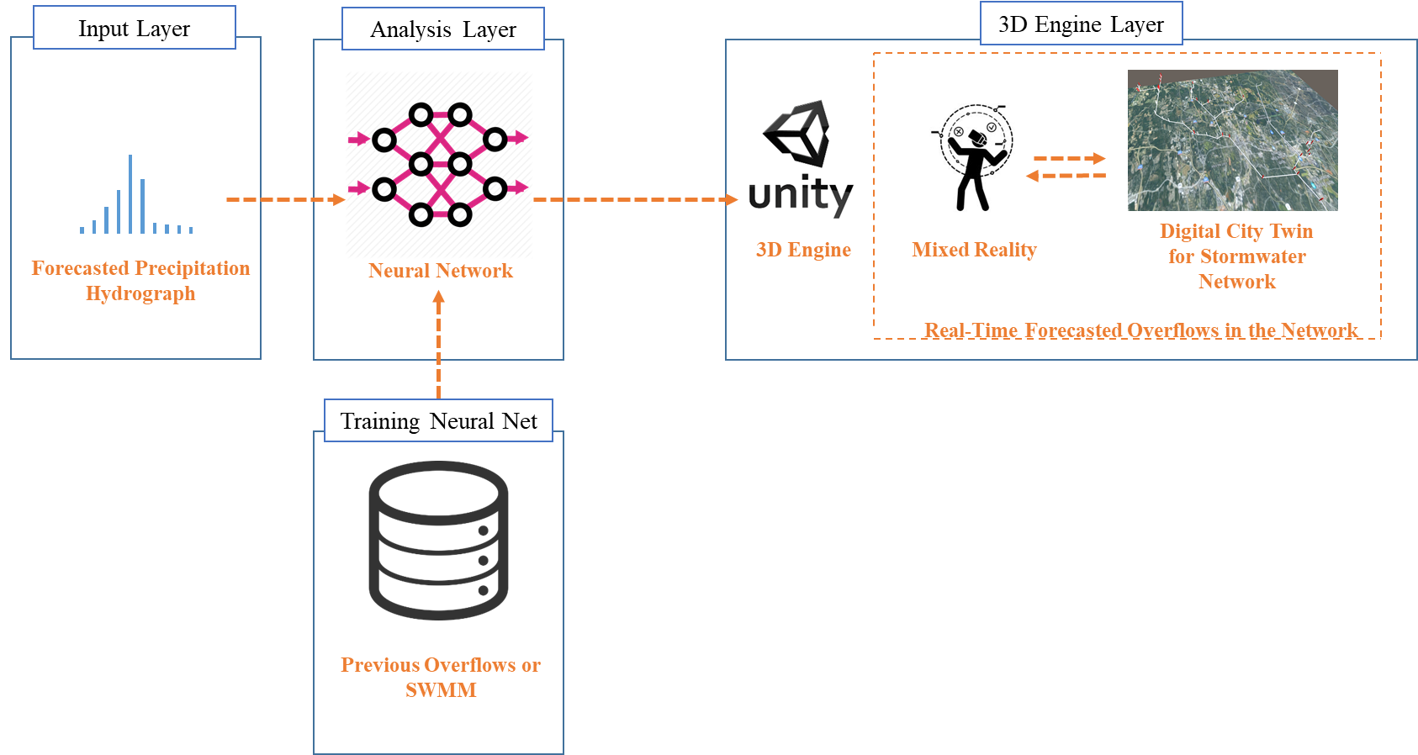
Methodology

Slide 19
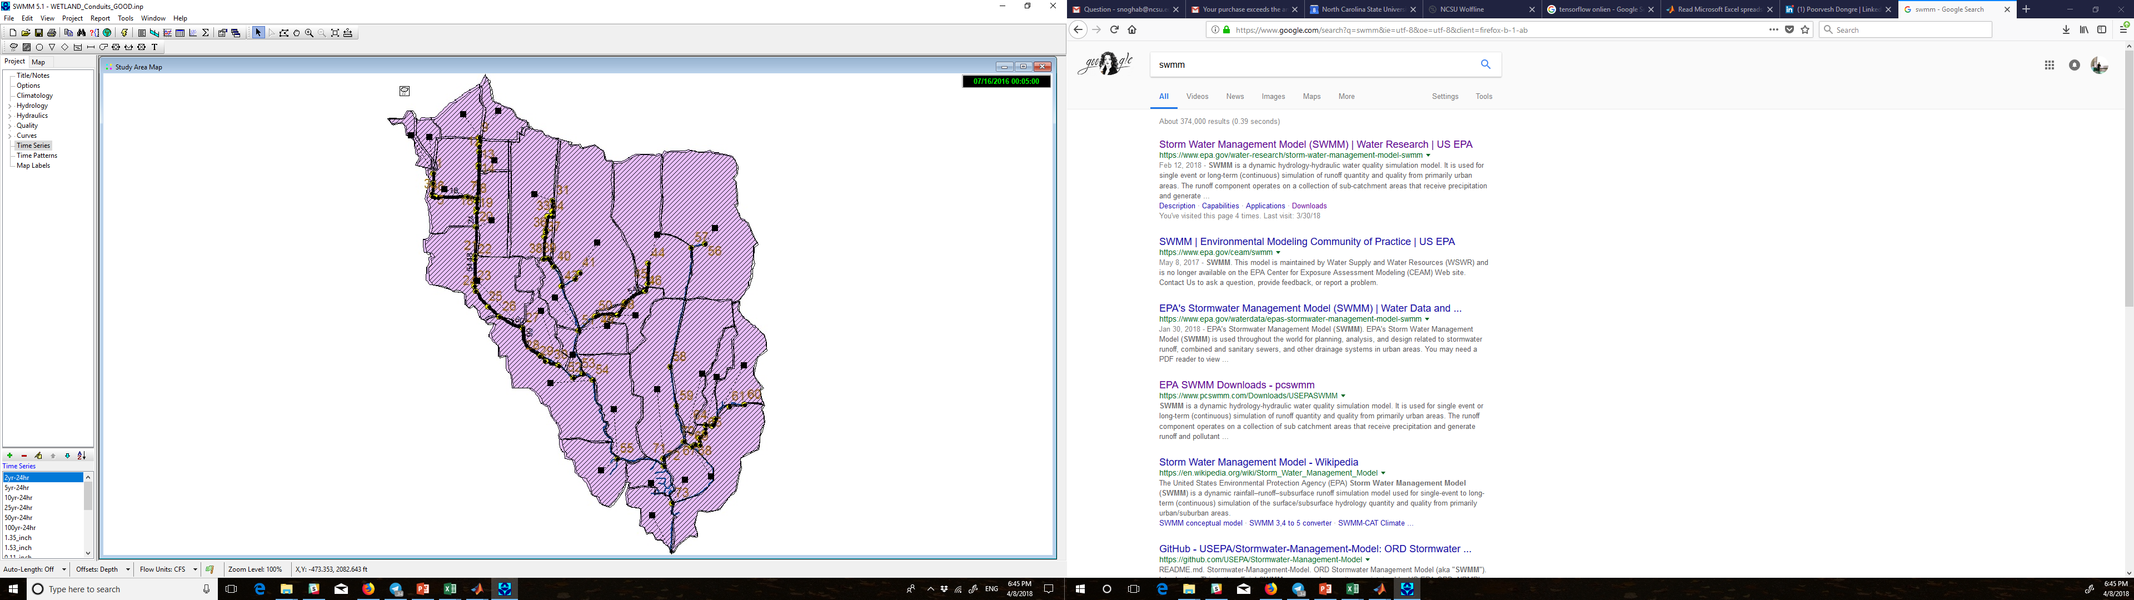
Phase 1: SWMM model data generation
Run SWMM for a number of different precipitations and find pipes or junctions with overflow problems
5 minute sampling hydrographs
All data is from city of Raleigh

Slide 20
Phase 2: Which Precipitations Cause Overflow Problems
Precipitation hydrograph
Precipitations with high peak

Slide 21
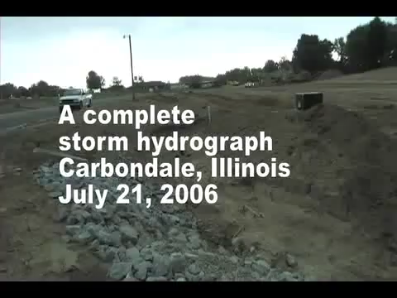
Phase 2: Which Precipitations Cause Overflow Problems
Notes:
40 Seconds

Slide 22
Make The Precipitation Shape More Simple
Simplify hydrograph with four numbers
Var. 2
Var. 1
Var. 3
Var. 4 (time)

Slide 23
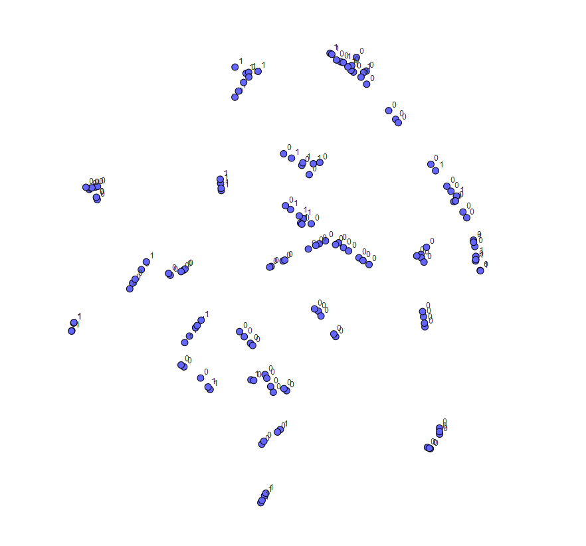
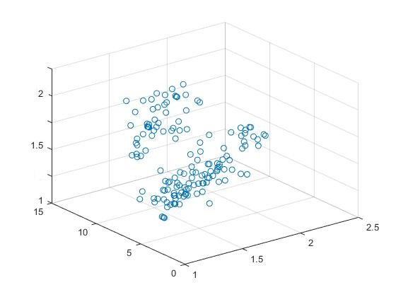
Data
Dataset (150 different hydrographs)
3 factor plotting
t-SNE chart

Slide 24
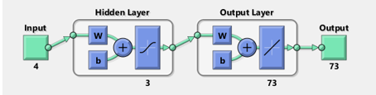
Machine Learning
Neural net fitting
4 inputs for each hydrograph
73 outputs for each junction in network(1 or 0)
3 hidden layers

Slide 25
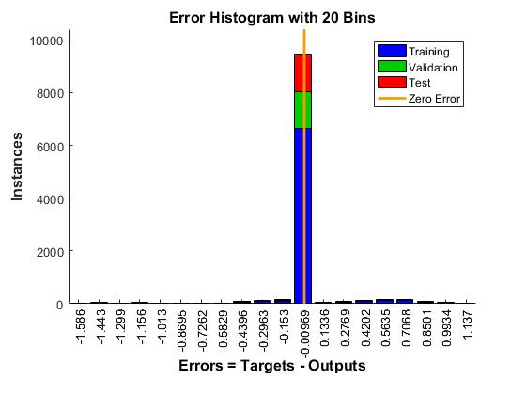
ML Results
70% training
15% validation
15% test

Slide 26
ML Results
MSE = 6.14e-2
R = 8.63e-1
Mean Squared Error is the average squared difference between outputs and targets. Lower values are better. Zero means no error.
Regression R Values measure the correlation between outputs and targets. An R value of 1 means a close relationship, 0 a random relationship.

Slide 27
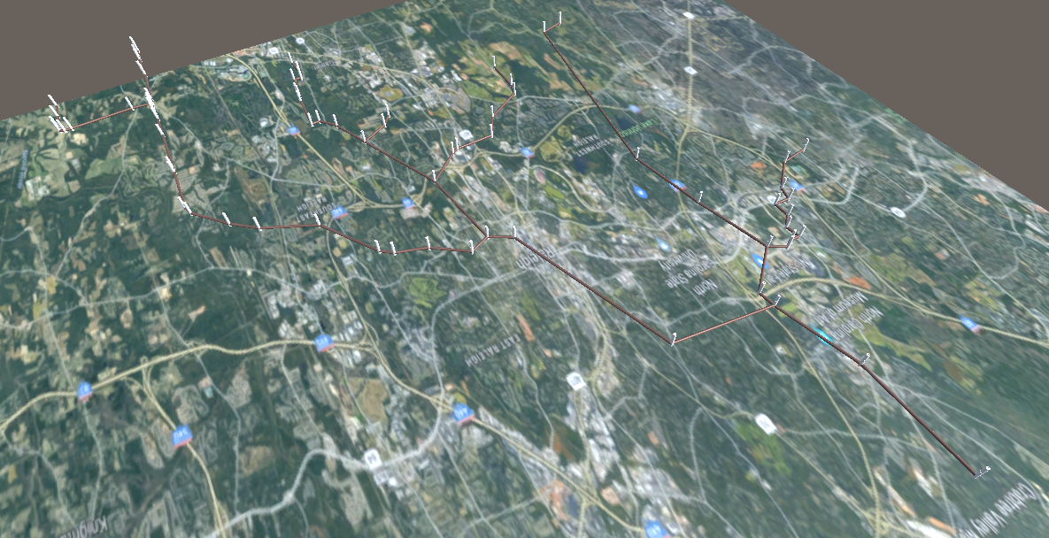
Unity Model
Water Flow Mapping

Slide 28
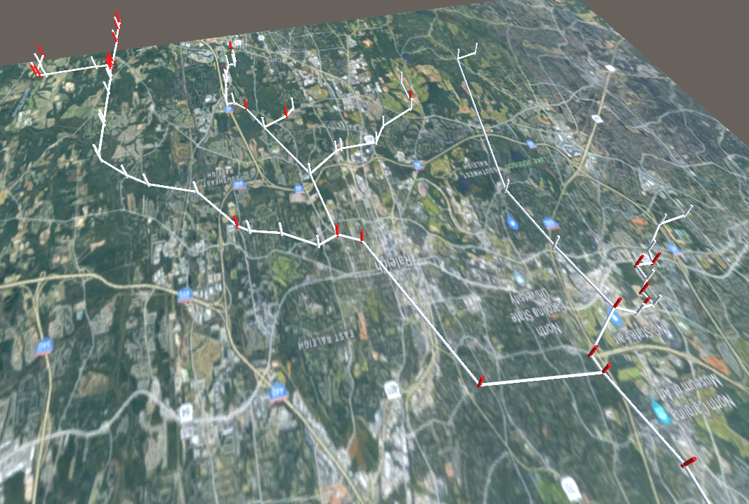
Results
Test a totally new test with just one misclassification
Neural Net
Forecasted hydrograph
Predicted overflow pipes in MR environment

Slide 29
Discussion
How your results answer the question that you identify in the background, “What has not been done in this area of research”
How do the results of your project help advance smart city applications
What is a vision for how you or other researchers could build on the results you have demonstrated and develop a complete smart city application

Slide 30
Discussion
How your results answer the question that

Slide 31
Limitation
Identify at least one criticism of smart cities that you identify from the literature and include citation
Does your project show evidence to support this criticism, or does it leave that criticism un addressed
What is the limitation of your project
How could future work that builds on your project address criticisms or limitations of smart cities applications

Slide 32
Limitation
We found the problems, but what we can do about it? How we can use our resource in an optimal way? How we can improve the accuracy of the neural net?

Slide 33
Conclusion
Summarize what you have done what are your findings and what are your contributions

Slide 34
Conclusion
Summarize what you have done what are

Slide 35
Thank You

